Slide 1

Spotify

Slide 2
Data Analysis
- Anushka Kave

Slide 3
Problem Statement : Spotify generates a large volume of streaming data that reveals insights into user engagement, track preferences, time-based trends, and session patterns. This project aims to extract those insights to improve recommendation algorithms, playlist curation, and user retention strategies.
Objectives : 1.Analyze Listener Preferences - Identify which artists, genres, and tracks are most popular among listeners.
2. Track Popularity Trends - Determine which features contribute most to a track’s success.
3. Artist Performance Insights - Find top-performing artists by number of tracks, average popularity, and energy.
4. Genre and Audio Feature Exploration - Identify genres that consistently produce popular or high-energy tracks.
5. Build Listener Personas - Cluster tracks based on features like danceability, valence, and acousticness to understand listener moods or preferences.
6. Data-Driven Decision Support - Provide actionable insights for music curators, marketers, or streaming services to promote content better.

Slide 4
Key Features of the Spotify Dataset :
Track and Artist Identification Enables analysis of user preferences with fields like trackName and artistName, useful for identifying top songs and favorite artists.
Precise Playback Timing The endTime column allows time-based analysis—daily trends, weekend vs. weekday patterns, and peak listening hours.
Listening Duration (msPlayed) Captures how long a song or episode was played. Helps in detecting skips, engagement levels, and partial vs. full listens.
Music vs. Podcast Segmentation Fields like episodeName and episodeShowName allow differentiation between music and podcast content for targeted insights.
User Behavior Patterns Tracks repeat listens vs. new discoveries, revealing patterns of loyalty, exploration, and daily listening habits.

Slide 5
Dataset Overview :
This dataset contains 149,860 Spotify track streaming records with fields including:- Track Name, Artist, Album- Playback Duration (ms), Platform, Timestamps- Skip Fla

Slide 6
SQL Queries

Slide 7
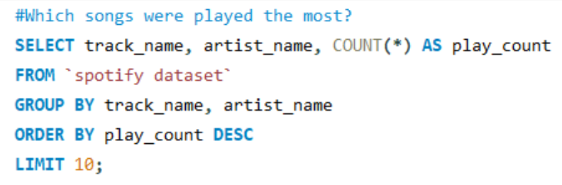
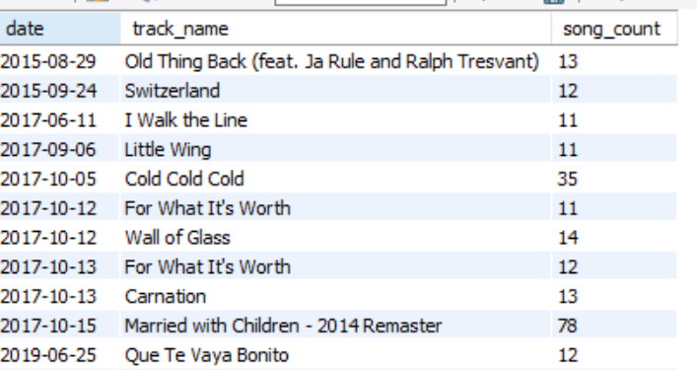
Q.1 Days when more than 10 songs were listened

Slide 8
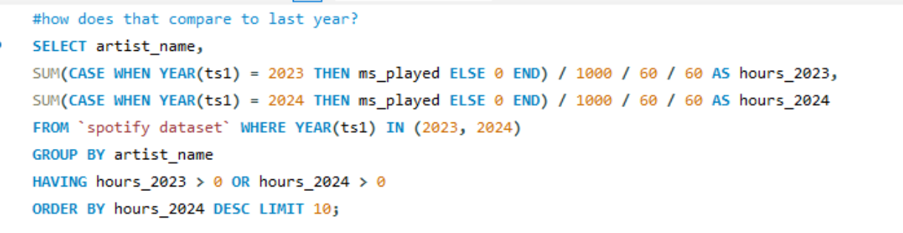
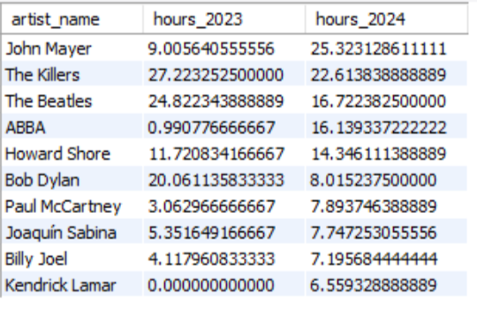
Q.2 how does that compare to last year?

Slide 9
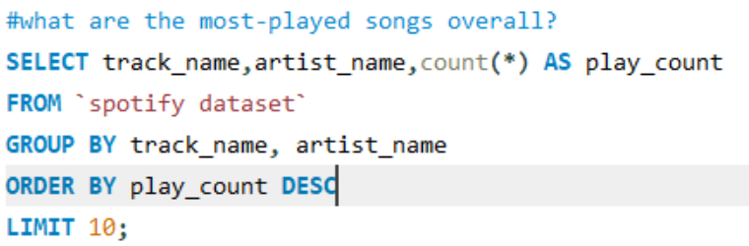
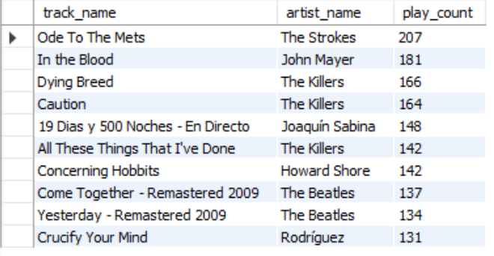
Q.3 what are the most-played songs overall?

Slide 10
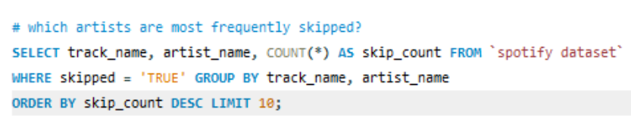
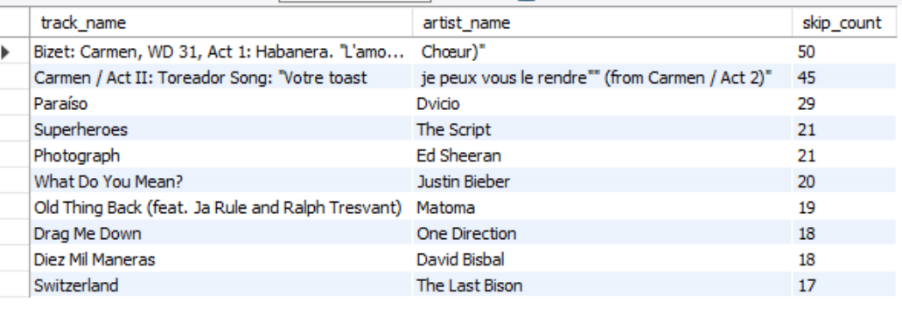
Q.4 which artists are most frequently skipped?

Slide 11

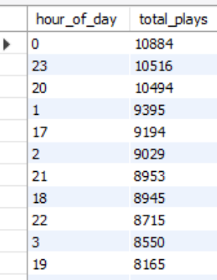
Q.5 What are the most common times of day or days of the week for music streaming ?
. Most Common Hours for Streaming

Slide 12
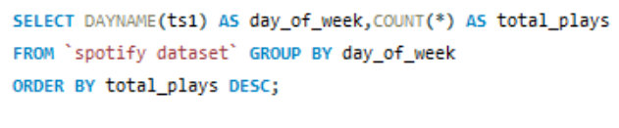
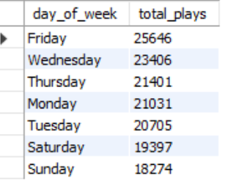
. Most Common Days of the Week

Slide 13
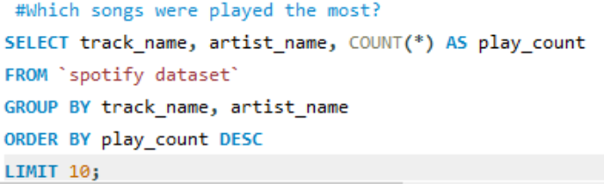
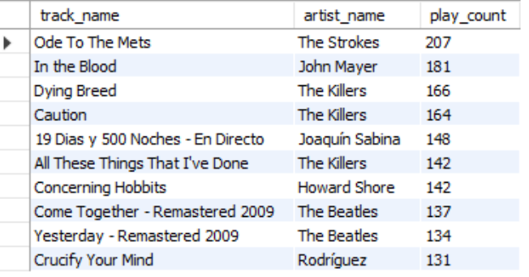
Q.6 Which songs were played the most?

Slide 14
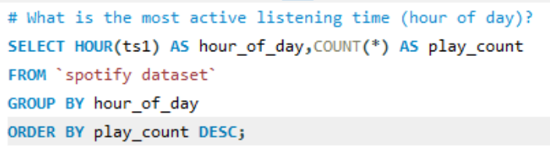
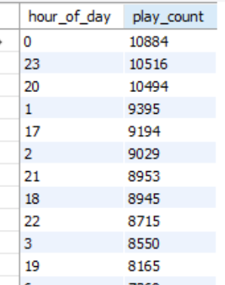
Q.7 What is the most active listening time (hour of day)?

Slide 15
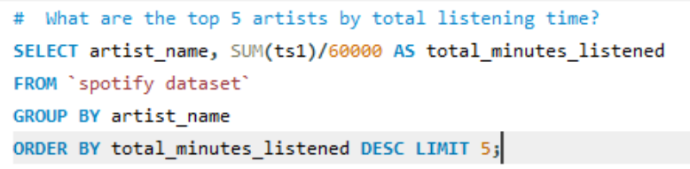
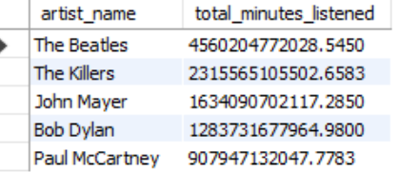
Q.8 What are the top 5 artists by total listening time?

Slide 16
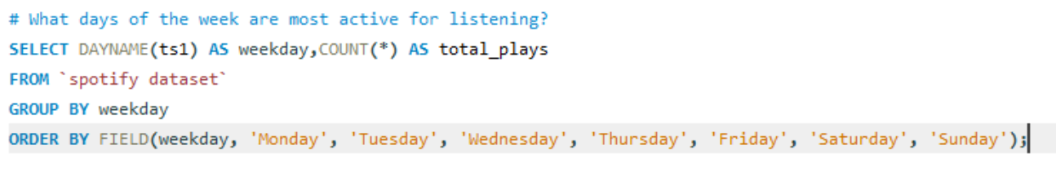
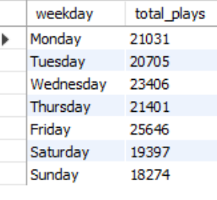
Q.9 What days of the week are most active for listening?

Slide 17
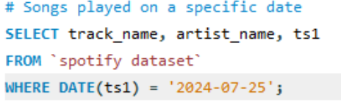
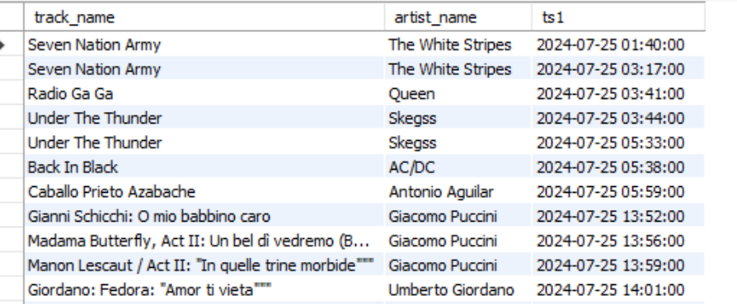
Q.10 Songs played on a specific date

Slide 18
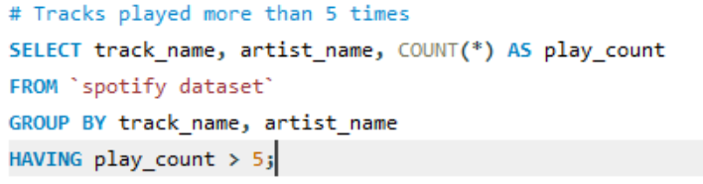
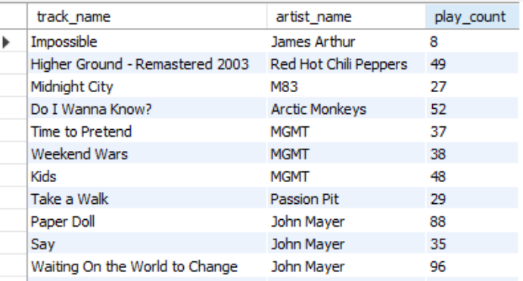
Q.11 Tracks played more than 5 times

Slide 19
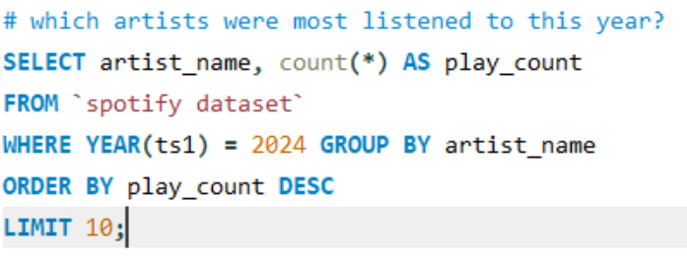
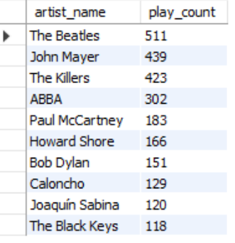
Q.12 which artists were most listened to this year?

Slide 20
“Thank You..

